Slide 1
Algorithms: Efficiency, Analysis, and Order
EXERCISES

Slide 2
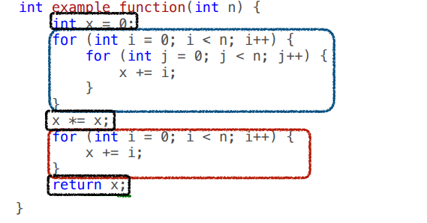
Question-1
Describe the complexity using Big O notation

Slide 3
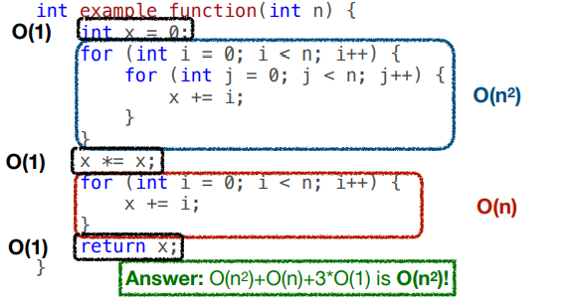
Solution to Exercise-1

Slide 4
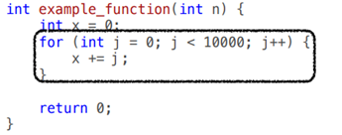
Question-2
Describe the complexity using Big O notation

Slide 5
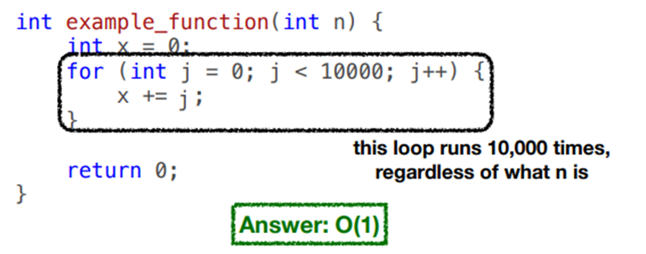
Solution to Exercise-2

Slide 6
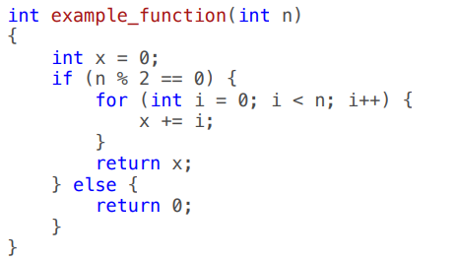
Question-3
Describe the complexity using Big O notation

Slide 7
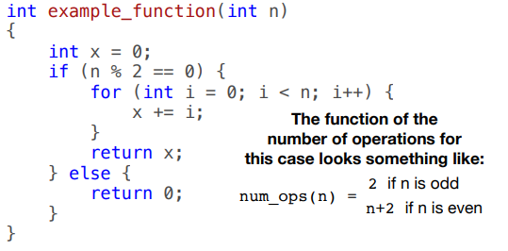
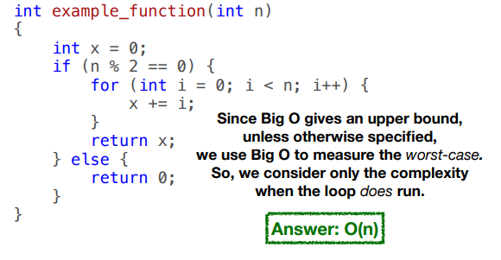
Solution to Exercise-3

Slide 8
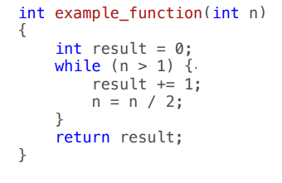
Question-4
Describe the complexity using Big O notation

Slide 9
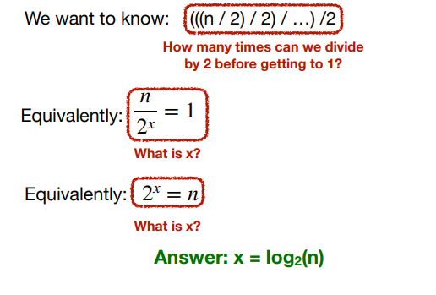
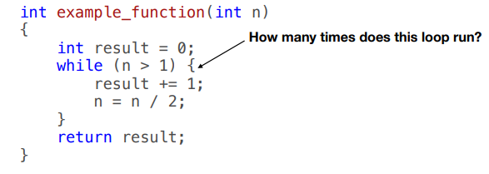
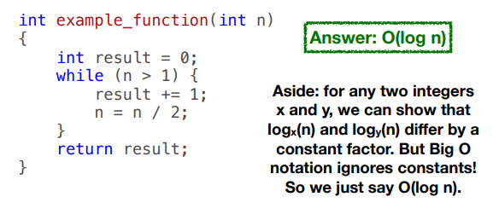
Solution to Exercise-4

Slide 10
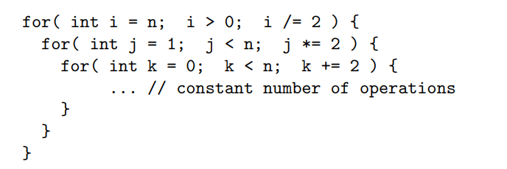
Question-5
Describe the complexity using Big O notation

Slide 11
Solution to Question-5
In the outer for-loop, the variable i keeps halving so it goes round log₂n times
For each i, next loop goes round also log₂n times, because of doubling the variable j
The innermost loop by k goes round n/2 times
Loops are nested, so the bounds may be multiplied to give that the algorithm is
O ( n(log n) ²)

Slide 12
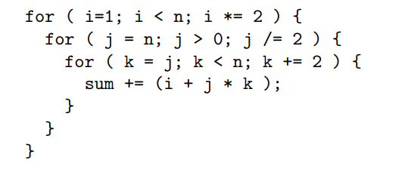
Question-6
Describe the complexity using Big O notation

Slide 13
Solution to Question-6
Running time of the inner, middle, and outer loop is proportional to n, log n, and log n, respectively
Thus the overall Big-Oh complexity is
O ( n(log n) ²)

Slide 14
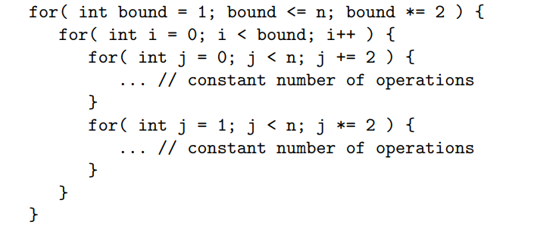
Question-7
Describe the complexity using Big O notation

Slide 15
Solution to Question-7
The first and second successive innermost loops have O(n) and O(log n), respectively
Thus, the overall complexity of the innermost part is O(n)
The outermost and middle loops have complexity O(log n) and O(n)
So, a straightforward and valid solution is that the overall complexity is
O(n² log n)

Slide 16
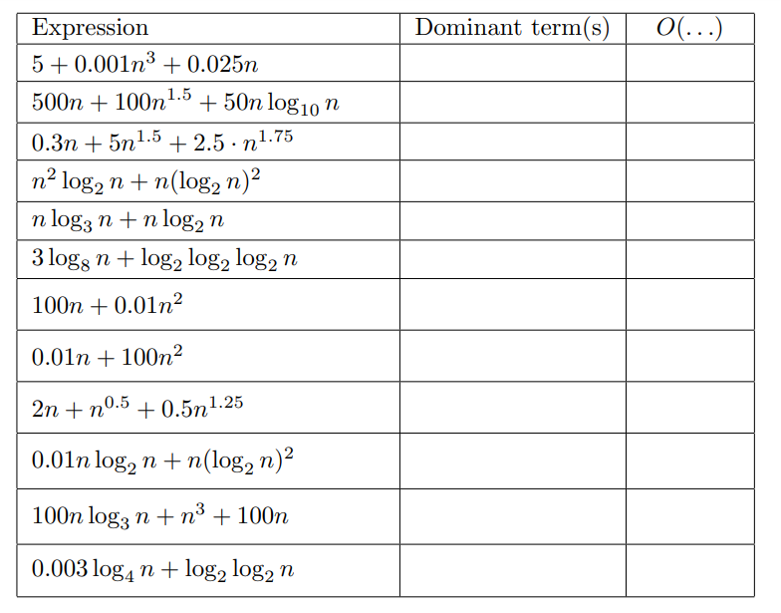
Question-8
Assume that each of the following expressions gives the processing time T(n) spent by an algorithm for solving a problem of size n
Select the dominant term(s) having the steepest increase in n and specify the lowest Big-Oh complexity of each algorithm

Slide 17
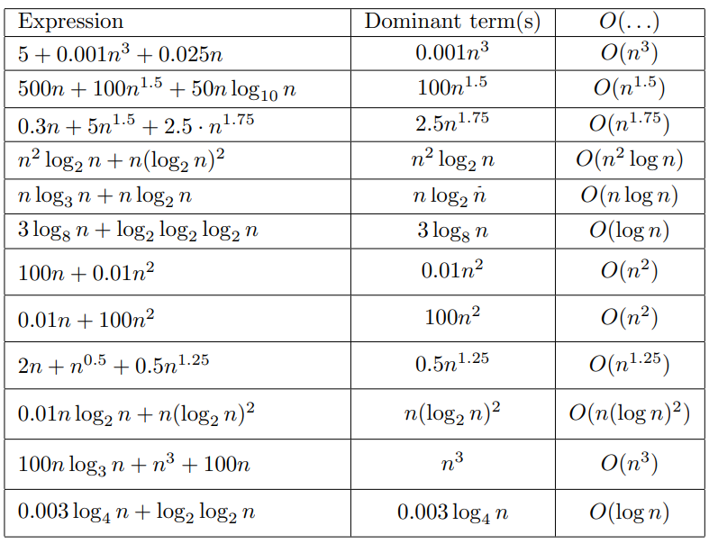
Solution to Exercise-8

Slide 18
Question-9
Algorithms A and B spend exactly T_{A}(n) = 5 n log₁₀n and T_{B}(n) = 25 n microseconds, respectively, for a problem of size n
Which algorithm is better in the Big-Oh sense?
For which problem sizes does it outperform the other?

Slide 19
Solution to Question-9
T_{A}(n) = 5 n log₁₀n and T_{B}(n) = 25 n
(n) is better than (n lg n) complexity. So, Algorithm B is better
Algorithm B outperforms the algorithm A if
T_{B}(n) ≤ T_{A}(n)
25 n ≤ 5n log₁₀n
5 ≤ log₁₀n
log₁₀n ≥ 5
n ≥ 10⁵
n ≥ 100,000

Slide 20
Question-10a
In each case below, demonstrate whether the given expression is true or false

Slide 21
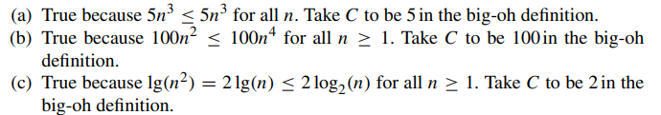
Solution to Question 10a

Slide 22
Question-10b
In each case below, determine whether the given expression is true or false

Slide 23
Solution to Question-10b

